Slide 1
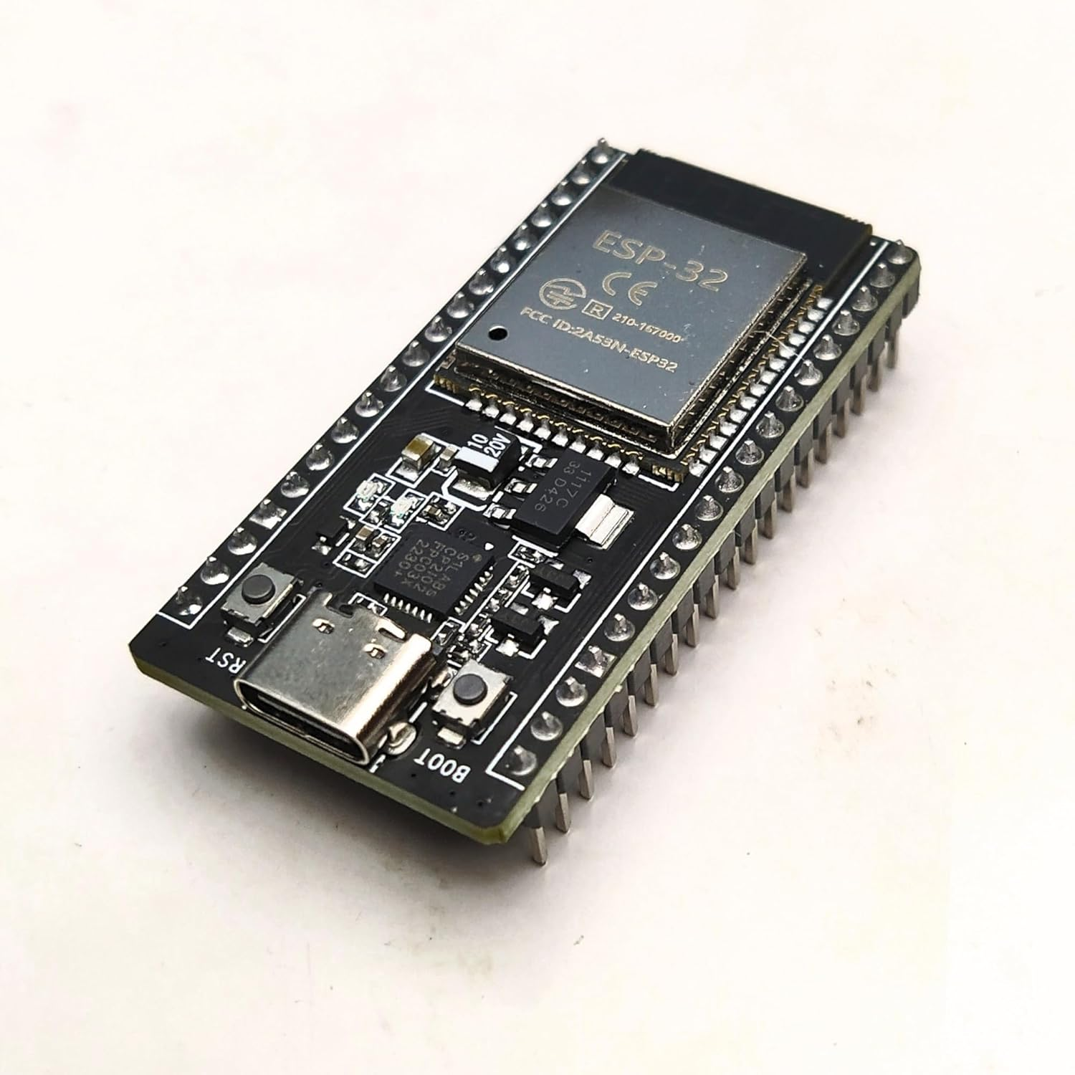

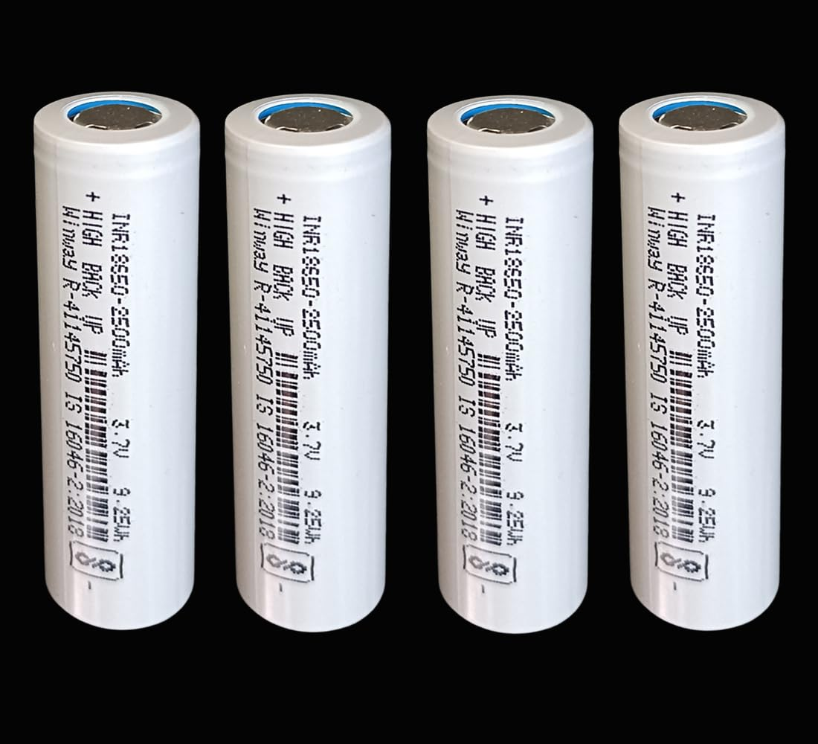

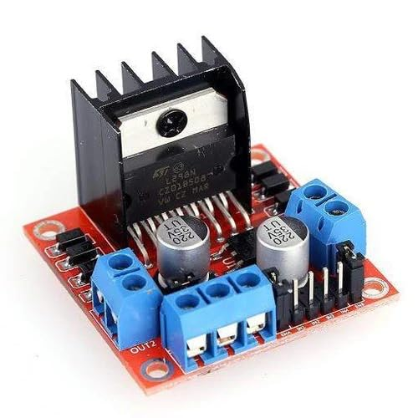
MOBILE_CONTROL_CAR_COMPONENT_LIST
https://amzn.in/d/epIncbi
https://amzn.in/d/6d72k4t
https://amzn.in/d/iJZHgr2
https://amzn.in/d/57IwPir
https://amzn.in/d/gFw9YLu

